Slide 1
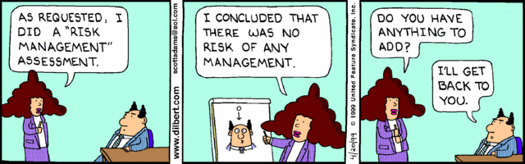
Risk Management
Phil Pfeiffer
Fall, 2014

Slide 2

Rationale
Success is foreseeing failure.
-- Henry Petoski, author,
To Engineer is Human
And preventing it!

Slide 3
Definition of Risk
Strict: deviation from expectation
  Positive deviation: opportunity
  Negative deviation: threat
Commonly identified with threats
  Focus of these notes
Noted in passing
  Opportunities as well as threats can create a need for rethinking plans

Slide 4
Essentials of Risk Mgmt.
Identify risks (i.e., threats)
  Can elicit by asking for concerns, doubts, issues, uncertainties
Analyze risks
  Estimate probability and consequences of each risk
  Prioritize overall set of risks
Plan for risks
  For each risk, define plan for resolving that risk
  Identify measurable thresholds for executing this plan
Track risks
  Monitor thresholds and risk status
  Use triggers to provide early warning
Resolve risks
  Implement plans in response to triggering events
  Continue efforts until risk reduced to acceptable levels
Hall, Managing Risk: Methods for Software Systems Development

Slide 5
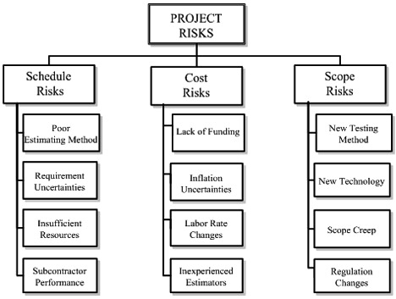
Identifying Risk: Risk Breakdown Structures

Slide 6
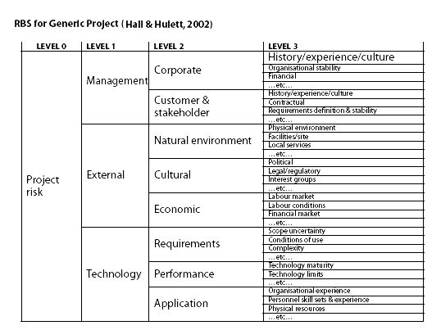
Identifying Risk: Risk Breakdown Structures

Slide 7
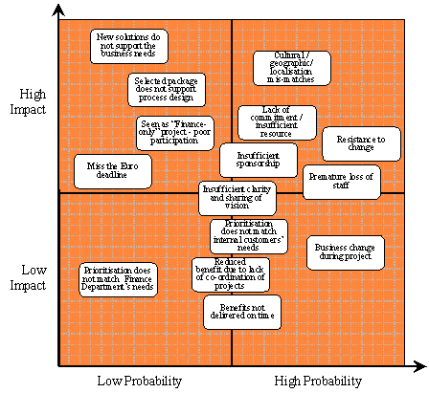
Analyzing Risk: Probability & Impact Matrices

Slide 8
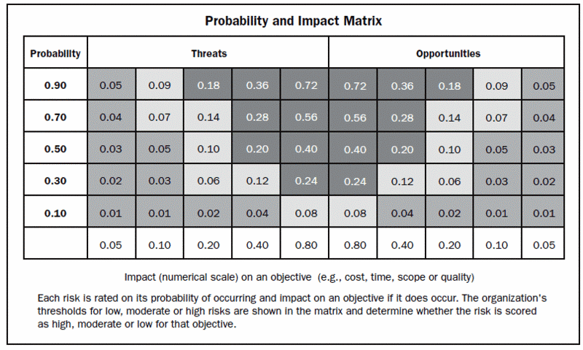
Analyzing Risk: Probability & Impact Matrices

Slide 9
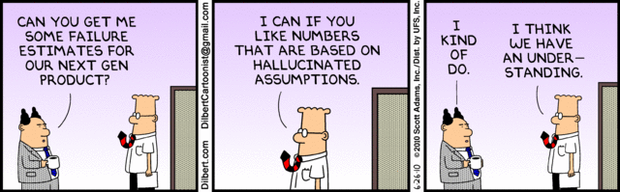
Risk Analysis: Purely Quantitative Analysis
Classic formula:
  risk exposure =
  probability of threat realization x probable loss from realized threat
Difficulties with formula: everything
  Determining probability that threat will be realized
  Determining probable loss from realized threat
Related result from comparable discipline (security):
  Empirical verification for quantitative models lacking
cf. Verendel, V. (2009). Quantified Security is a Weak Hypothesis. NSPW '09 Proceedings of the 2009 workshop on New security paradigms workshop . New York: ACM.

Slide 10
Risk Analysis: Semi-Quantitative Analysis
Modified formula:
  risk exposure =
  rough probability of realization (e.g., 1…5)
  x rough probable loss from threat (e.g., 1..5)
Much more common
Use
  Assign numeric value to risks
  Rank, using "top N risks list" (e.g., top 10 risks)
  Address in order of priority

Slide 11
Risk Analysis: Qualitative Analysis
Use expert judgment (e.g., Delphi) to identify, rank top N risks
Address in order of priority

Slide 12
Planning for Risk: Strategies
For threats:
Avoid
  Change plan to completely eliminate threat
Mitigate
  Change plan to reduce a threat's probability of occurrence and/or probable impacts
Transfer
  Shift some or all of impact to another party
Accept
  Do nothing special to address the threat
For opportunities:
Exploit
  Change plan to ensure opportunity is realized
Enhance
  Change plan to increase an opportunities probability of occurrence and/or probable benefits
Share
  Allocate some or all of benefit to another party
Accept
  Do nothing special to exploit the opportunity

Slide 13
Planning for Risks: Scenarios
Idea:
  develop use cases that describe what can go wrong
  plan for risk by developing responses to use cases
Example
  Bostrom et al. suggest extending XP for secure systems by adding two kinds of user stories:
    abuser stories -
    form basis for risk assessment (e.g., testing)
    security-related user stories -
    form basis for addressing risk
Bostrom, G., Wayrynen, J., Boden, M., Beznosov, K., & Kruchten, P. (2006). Extending XP Practices to Support Security Requirements Engineering. SESS '06. ACM.

Slide 14
Planning for Risks:
"Common Knowledge" Checklists
Two kinds
  Lists of common risks
    Readily available via Internet search
  Lists of common countermeasures
    Also known as "best practices"
Appeal is legalistic and logistic (due diligence)
  Assumed to reduce risk of being found negligent
    "Everyone else does it"
  Reduces effort of analysis

Slide 15
Planning for Risks: Setting Triggers
Examples
  Scheduled events: e.g., monthly reports, reviews
  Elapsed time: e.g., approach of a milestone
  Threshold values: i.e., excessive values in a quantity: e.g.,
    Cost threshold exceeded
    Defect count above a threshold
  Variance: i.e., excess values in a rate-of-change metric: e.g.,
    Rate of increase in defects above a threshold
    TCPI (to-complete cost performance index)
    expected rate of code committal to project archive
Advantages of using common features: can be readily monitored, detected
Hall, Managing Risk: Methods for Software Systems Development

Slide 16
Recommended Risk Mgmt. Strategies
Be proactive
  Facilitator useful when time or skills are lacking
Integrate risk mgmt. into routine project activities
Be systematic about risk control
  Hall recommends spending 20% of time on assessment and 80% on control
  "It is better to resolve a few risks than it is to identify many risks but do nothing with the risk information."
Be disciplined about risk management
  Hall's formula: envision, plan, work, measure, improve, and discover
Hall, Managing Risk: Methods for Software Systems Development

